Slide 1
V-Menu
Team Two

Slide 2

TEAM Members
Matthew Boyette – Lead Developer
William Mejia – Developer
Demetrius Myers – Developer
Slaven Popadic – Lead Designer

Slide 3

Automated Testing in Drupal 8
Unit Tests (Low Level)
Uses standard PHPUnit framework
Tests individual class functionality
Functional Tests (High Level)
Uses Drupal’s SimpleTest module
Tests system functionality
Involves web output

Slide 4

Automated Testing in Drupal 8
Goal is to have test coverage for all or most of the components and features
Automation is enabled via Cron, the standard Unix time-based task-scheduler
Tests are run before and after every code change
Makes regression testing simple and efficient

Slide 5

Code Patches
Patches to fix bugs
Includes a test that fails without the changes, and passes with the changes.
Patches to implement new features
Includes new unit and/or functional tests in the patch.

Slide 6
General Testing Approach
Egoless Attitude – our Drupal module is just one of many. It needs to play nice with the rest of the Drupal ecosystem and conform to existing standards.
Unit tests use blackbox approach.
Functional tests use whitebox approach.
Combination of blackbox and whitebox testing means we can be confident that we have completely tested each component.
Integration testing occurs at each stage of the development process using the sandwhich approach discussed in class.

Slide 7
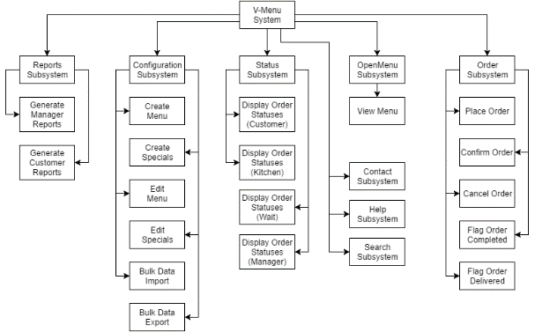
Functional Decomposition Diagram

Slide 8
Test Case #1
Preconditions/Setup: Tester must be at the home page.
Requirement(s) Tested: View Menu
Action 1: Tester activates View Menu link.
Verify 1: Tester confirms that the menu page is displayed within the content pane.

Slide 9
Test Case #3
Preconditions/Setup: Tester must have placed an order, and be at the order confirmation page.
Requirement(s) Tested: Confirm/Cancel Order
Action 1: Tester activates the Confirm Order button.
Verify 1: Tester confirms that they are now prompted for payment information.
Action 2: Tester enters payment information, and activates the Complete Order button.
Verify 2: Tester confirms that they receive their receipt via email.

Slide 10
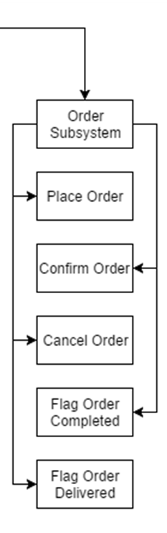
Test Case #4
Preconditions/Setup: Tester must have placed an order, and be at the order confirmation page.
Requirement(s) Tested: Confirm/Cancel Order
Action 1: Tester fails to activate the Confirm Order button (either by leaving the confirmation page or losing connection to the server).
Action 2: Tester activates the Orders navbar link.
Verify 1: Tester confirms that nothing was added to the order status page.

Slide 11
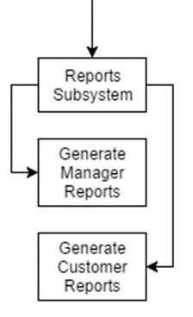
Test Case #13
Preconditions/Setup: Tester must be logged in as a Manager.
Requirement(s) Tested: View Manager Reports
Action 1: Tester activates the Reports navbar link.
Verify 1: Tester confirms that the Reports page is displayed within the content pane.
Action 2: Tester selects the desired report.
Verify 2: Tester confirms that the selected report is displayed on the page.

Slide 12

Questions and Answers

